Slide 1
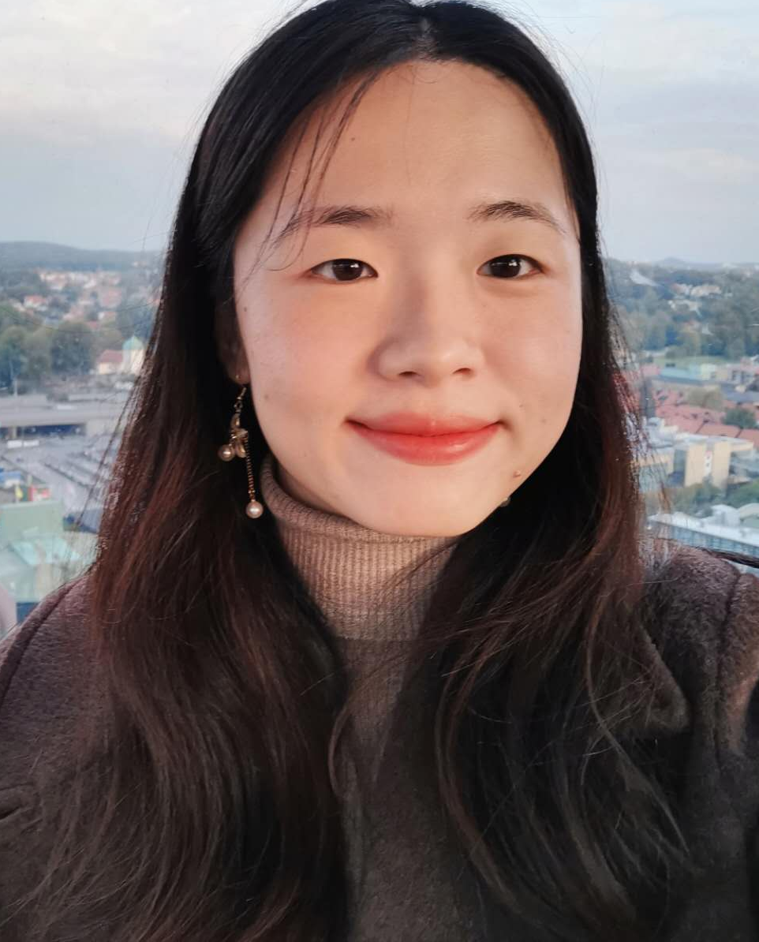
Xingrong Zong – Personal Letter
Software Technology
I am writing to express my strong interest in the internship (LIA) position at xxxxx, which was advertised at xxxxx. As a highly motivated and results-driven individual, I believe that my attention to detail and ability to work well under pressure makes me a strong candidate for this position.
Currently, I am enrolled in the “International Business Logistics – Green Management” at Hermods, where my interest in the field has grown substantially. This interest has been fuelled not only by my multilingual skills but also by my desire to comprehend how logistics intertwines and influences our lives. For instance, the dynamics of logistics throughout the recent pandemic years, including how it adapted and restructured, its economic implications and contributions, as well as the challenges it presented to various sectors and industries.
I am looking for a company that provides a global work environment where I can leverage my language and communication strengths to the fullest. If I am chosen as an intern at xxxxx, with my quick learning ability and a computer science background, I am confident that I can quickly integrate into your team and I will work hard towards the objectives and goals of your team.
Thank you for considering my application. I am eager to join xxxxx and contribute to your continued success in logistics. I look forward to the opportunity to discuss my qualifications with you in person.
Sincerely,
Xingrong Zong
16/10/2023
ronazong.work@gmail.com
linkedin.com/in/ronazong
github.com/RonaZong
0761-66 52 46
Ebbe Lieberathsgatan 33B
41265 Gothenburg

Slide 2
Xingrong Zong – Personal Letter
Software Technology
I am writing to express my strong interest in the internship (LIA) position at ASSA ABLOY, which was advertised at ASSA ABLOY. As a highly motivated and results-driven individual, I believe that my attention to detail and ability to work well under pressure makes me a strong candidate for this position.
Currently, I am enrolled in the “International Business Logistics – Green Management” at Hermods, where my interest in the field has grown substantially. This interest has been fuelled not only by my multilingual skills but also by my desire to comprehend how logistics intertwines and influences our lives. For instance, the dynamics of logistics throughout the recent pandemic years, including how it adapted and restructured, its economic implications and contributions, as well as the challenges it presented to various sectors and industries.
I am looking for a company that provides a global work environment where I can leverage my language and communication strengths to the fullest. If I am chosen as an intern at ASSA ABLOY, with my quick learning ability and a computer science background, I am confident that I can quickly integrate into your team and I will work hard towards the objectives and goals of your team.
Thank you for considering my application. I am eager to join ASSA ABLOY and contribute to your continued success in logistics. I look forward to the opportunity to discuss my qualifications with you in person.
Sincerely,
Xingrong Zong
06/11/2023
ronazong.work@gmail.com
linkedin.com/in/ronazong
github.com/RonaZong
0761-66 52 46
Ebbe Lieberathsgatan 33B
41265 Gothenburg

Slide 3
Xingrong Zong – Personal Letter
Software Technology
I am writing to express my strong interest in the internship (LIA) position at Geodis, which was shared at Hermods. As a highly motivated and results-driven individual, I believe that my attention to detail and ability to work well under pressure makes me a strong candidate for this position.
Currently, I am enrolled in the “International Business Logistics – Green Management” at Hermods, where my interest in the field has grown substantially. This interest has been fuelled not only by my multilingual skills but also by my desire to comprehend how logistics intertwines and influences our lives. For instance, the dynamics of logistics throughout the recent pandemic years, including how it adapted and restructured, its economic implications and contributions, as well as the challenges it presented to various sectors and industries.
I am looking for a company that provides a global work environment where I can leverage my language and communication strengths to the fullest. If I am chosen as an intern at Geodis, with my quick learning ability and a computer science background, I am confident that I can quickly integrate into your team and I will work hard towards the objectives and goals of your team.
Thank you for considering my application. I am eager to join Geodis and contribute to your continued success in logistics. I look forward to the opportunity to discuss my qualifications with you in person.
Sincerely,
Xingrong Zong
03/11/2023
ronazong.work@gmail.com
linkedin.com/in/ronazong
github.com/RonaZong
0761-66 52 46
Ebbe Lieberathsgatan 33B
41265 Gothenburg

Slide 4
Xingrong Zong – Personal Letter
Software Technology
I am writing to express my strong interest in the internship (LIA) position at ITS. As a highly motivated and results-driven individual, I believe that my attention to detail and ability to work well under pressure makes me a strong candidate for this position.
Currently, I am enrolled in the “International Business Logistics – Green Management” at Hermods, where my interest in the field has grown substantially. This interest has been fuelled not only by my multilingual skills but also by my desire to comprehend how logistics intertwines and influences our lives. For instance, the dynamics of logistics throughout the recent pandemic years, including how it adapted and restructured, its economic implications and contributions, as well as the challenges it presented to various sectors and industries.
I am looking for a company that provides a global work environment where I can leverage my language and communication strengths to the fullest. If I am chosen as an intern at ITS, with my quick learning ability and a computer science background, I am confident that I can quickly integrate into your team and I will work hard towards the objectives and goals of your team.
Thank you for considering my application. I am eager to join ITS and contribute to your continued success in logistics. I look forward to the opportunity to discuss my qualifications with you in person.
Sincerely,
Xingrong Zong
03/11/2023
ronazong.work@gmail.com
linkedin.com/in/ronazong
github.com/RonaZong
0761-66 52 46
Ebbe Lieberathsgatan 33B
41265 Gothenburg

Slide 5
Xingrong Zong – Personal Letter
Software Technology
I am writing to express my strong interest in the internship (LIA) position at Scandinavian Shipping, which was advertised at your website. As a highly motivated and results-driven individual, I believe that my attention to detail and ability to work well under pressure makes me a strong candidate for this position.
Currently, I am enrolled in the “International Business Logistics – Green Management” at Hermods, where my interest in the field has grown substantially. This interest has been fuelled not only by my multilingual skills but also by my desire to comprehend how logistics intertwines and influences our lives. For instance, the dynamics of logistics throughout the recent pandemic years, including how it adapted and restructured, its economic implications and contributions, as well as the challenges it presented to various sectors and industries.
I am looking for a company that provides a global work environment where I can leverage my language and communication strengths to the fullest. If I am chosen as an intern at Scandinavian Shipping, with my quick learning ability and a computer science background, I am confident that I can quickly integrate into your team and I will work hard towards the objectives and goals of your team.
Thank you for considering my application. I am eager to join Scandinavian Shipping and contribute to your continued success in logistics. I look forward to the opportunity to discuss my qualifications with you in person.
Sincerely,
Xingrong Zong
02/11/2023
ronazong.work@gmail.com
linkedin.com/in/ronazong
github.com/RonaZong
0761-66 52 46
Ebbe Lieberathsgatan 33B
41265 Gothenburg

Slide 6
Xingrong Zong – Personal Letter
Software Technology
I am writing to express my strong interest in the internship (LIA) position at Volvo Cars, which was shared by the graduate from the same major. As a highly motivated and results-driven individual, I believe that my attention to detail and ability to work well under pressure makes me a strong candidate for this position.
Currently, I am enrolled in the “International Business Logistics – Green Management” at Hermods, where my interest in the field has grown substantially. This interest has been fuelled not only by my multilingual skills but also by my desire to comprehend how logistics intertwines and influences our lives. For instance, the dynamics of logistics throughout the recent pandemic years, including how it adapted and restructured, its economic implications and contributions, as well as the challenges it presented to various sectors and industries.
I am looking for a company that provides a global work environment where I can leverage my language and communication strengths to the fullest. If I am chosen as an intern at Volvo Cars, with my quick learning ability and a computer science background, I am confident that I can quickly integrate into your team and I will work hard towards the objectives and goals of your team.
Thank you for considering my application. I am eager to join Volvo Cars and contribute to your continued success in logistics. I look forward to the opportunity to discuss my qualifications with you in person.
Sincerely,
Xingrong Zong
01/11/2023
ronazong.work@gmail.com
linkedin.com/in/ronazong
github.com/RonaZong
0761-66 52 46
Ebbe Lieberathsgatan 33B
41265 Gothenburg

Slide 7
Xingrong Zong – Personal Letter
Software Technology
I am writing to express my strong interest in the internship (LIA) position at Kuehne+Nagel, which was advertised at LinkedIn. As a highly motivated and results-driven individual, I believe that my attention to detail and ability to work well under pressure makes me a strong candidate for this position.
Currently, I am enrolled in the “International Business Logistics – Green Management” at Hermods, where my interest in the field has grown substantially. This interest has been fuelled not only by my multilingual skills but also by my desire to comprehend how logistics intertwines and influences our lives. For instance, the dynamics of logistics throughout the recent pandemic years, including how it adapted and restructured, its economic implications and contributions, as well as the challenges it presented to various sectors and industries.
I am looking for a company that provides a global work environment where I can leverage my language and communication strengths to the fullest. If I am chosen as an intern at Kuehne+Nagel, with my quick learning ability and a computer science background, I am confident that I can quickly integrate into your team and I will work hard towards the objectives and goals of your team.
Thank you for considering my application. I am eager to join Kuehne+Nagel and contribute to your continued success in logistics. I look forward to the opportunity to discuss my qualifications with you in person.
Sincerely,
Xingrong Zong
19/10/2023
ronazong.work@gmail.com
linkedin.com/in/ronazong
github.com/RonaZong
0761-66 52 46
Ebbe Lieberathsgatan 33B
41265 Gothenburg

Slide 8
Xingrong Zong – Personal Letter
Software Technology
I am writing to express my strong interest in the internship (LIA) position at Schenker, which was advertised at the Hermods LIA event. Our conversation during the event left a positive impression, and I was greatly impressed by the opportunities at Schenker. As a highly motivated and results-driven individual, I believe that my attention to detail and ability to work well under pressure makes me a strong candidate for this position.
Currently, I am enrolled in the “International Business Logistics – Green Management” at Hermods, where my interest in the field has grown substantially. This interest has been fuelled not only by my multilingual skills but also by my desire to comprehend how logistics intertwines and influences our lives. For instance, the dynamics of logistics throughout the recent pandemic years, including how it adapted and restructured, its economic implications and contributions, as well as the challenges it presented to various sectors and industries.
I am looking for a company that provides a global work environment where I can leverage my language and communication strengths to the fullest. If I am chosen as an intern at Schenker, with my quick learning ability and a computer science background, I am confident that I can quickly integrate into your team and I will work hard towards the objectives and goals of your team.
Thank you for considering my application. I am eager to join Schenker and contribute to your continued success in logistics. I look forward to the opportunity to discuss my qualifications with you in person.
Sincerely,
Xingrong Zong
16/10/2023
ronazong.work@gmail.com
linkedin.com/in/ronazong
github.com/RonaZong
0761-66 52 46
Ebbe Lieberathsgatan 33B
41265 Gothenburg

